Slide 1

Computer Operating Systems BLG 312E Week-13 (Lecture-12)
Prof. Dr. Kemal Bıçakcı

Slide 2
Review Question
What is the absolute path name of the file with the relative path name of ../mehmet/x in the /usr/ahmet folder?
/usr/ahmet/mehmet/x
../mehmet/x
/usr/mehmet/x
/mehmet/x

Slide 3
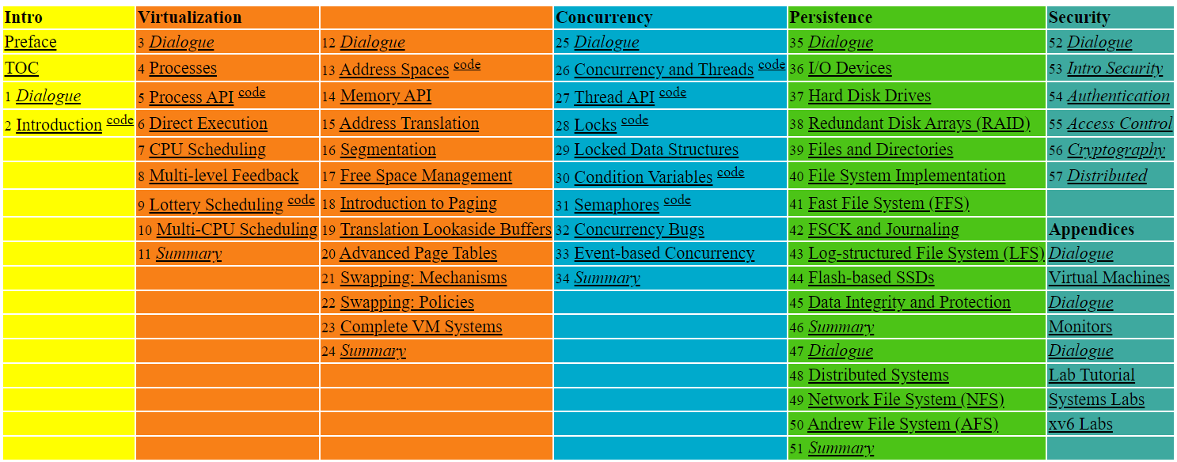

Slide 4
40. File System Implementation
Operating System: Three Easy Pieces

Slide 5
What is ``secure erase’’?

Slide 6
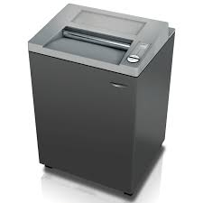

What is ``secure erase’’?

Slide 7
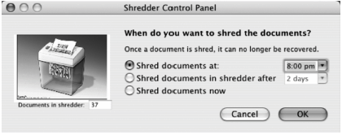
Mental Models
the use of a correct metaphor (shredder) for secure erase

Slide 8
The Way To Think
There are two different aspects to implement a file system
Data structures
What types of on-disk structures are utilized by the file system to organize its data and metadata?
Access methods
How does it map the calls made by a process like open(), read(), write(), etc.
Which structures are read during the execution of a particular system call?

Slide 9
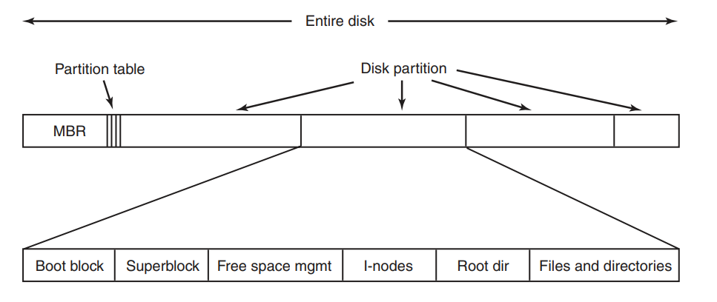
A Possible File System Layout

Slide 10
File System Layout
File systems are stored on disks.
Most disks can be divided up into one or more partitions, with independent file systems on each partition.
Sector 0 of the disk is called the MBR (Master Boot Record) and is used to boot the computer.
The end of the MBR contains the partition table. This table gives the starting and ending addresses of each partition.
One of the partitions in the table is marked as active.
When the computer is booted, the BIOS reads in and executes the MBR.
The first thing the MBR program does is locate the active partition, read in its first block, which is called the boot block, and execute it.
The program in the boot block loads the operating system contained in that partition.

Slide 11
File System Layout (Cont’d)
For uniformity, every partition starts with a boot block, even if it does not contain a bootable operating system. Besides, it might contain one in the future.
Other than starting with a boot block, the layout of a disk partition varies a lot from file system to file system.
Often the file system will contain some of the items shown.
The first one is the superblock. It contains all the key parameters about the file system and is read into memory when the computer is booted or the file system is first touched.
Typical information in the superblock includes a magic number to identify the file-system type, the number of blocks in the file system, and other key administrative information.

Slide 12
Overall Organization
Let’s develop the overall organization of the file system data structure.
First, divide the disk into blocks.
Block size is 4 KB.
The blocks are addressed from 0 to N -1.
0 7
8 15
16 23
24 31
32 39
40 47
48 55
56 63

Slide 13
Data region in file system
Reserve data region to store user data
File system has to track which data blocks comprise a file, the size of the file, its owner, etc.
Data Region
D | D | D | D | D | D | D | D
D | D | D | D | D | D | D | D
D | D | D | D | D | D | D | D
0 7
8 15
16 23
24 31
Data Region
D | D | D | D | D | D | D | D
D | D | D | D | D | D | D | D
D | D | D | D | D | D | D | D
D | D | D | D | D | D | D | D
32 39
40 47
48 55
56 63
How do we store these inodes in file system?

Slide 14
Inode table in file system
Reserve some space for inode table
This holds an array of on-disk inodes.
Example: for inode tables: use blocks# 3 ~ 7, inode size : 256 bytes
4-KB block can hold 16 inodes.
The filesystem contains 80 inodes (maximum number of files)
Inodes
Data Region
 | i | d | I | I | I | I | I
D | D | D | D | D | D | D | D
D | D | D | D | D | D | D | D
D | D | D | D | D | D | D | D
0 7
8 15
16 23
24 31
Data Region
D | D | D | D | D | D | D | D
D | D | D | D | D | D | D | D
D | D | D | D | D | D | D | D
D | D | D | D | D | D | D | D
32 39
40 47
48 55
56 63

Slide 15
Allocation Structures
This is to track whether inodes or data blocks are free or allocated.
Use bitmap, each bit indicates free(0) or in-use(1)
data bitmap: for data region
inode bitmap: for inode table
Inodes
Data Region
 | i | d | I | I | I | I | I
D | D | D | D | D | D | D | D
D | D | D | D | D | D | D | D
D | D | D | D | D | D | D | D
0 7
8 15
16 23
24 31
Data Region
D | D | D | D | D | D | D | D
D | D | D | D | D | D | D | D
D | D | D | D | D | D | D | D
D | D | D | D | D | D | D | D
32 39
40 47
48 55
56 63

Slide 16
Superblock
Super block contains the information for a particular file system
Example: The number of inodes, begin location of inode table. etc
Thus, when mounting a file system, OS will read the superblock first, to initialize various information.
Inodes
Data Region
S | i | d | I | I | I | I | I
D | D | D | D | D | D | D | D
D | D | D | D | D | D | D | D
D | D | D | D | D | D | D | D
0 7
8 15
16 23
24 31
Data Region
D | D | D | D | D | D | D | D
D | D | D | D | D | D | D | D
D | D | D | D | D | D | D | D
D | D | D | D | D | D | D | D
32 39
40 47
48 55
56 63

Slide 17
File Organization: The inode
Each inode is referred to by its inode number.
By inode number, file system calculates where the inode is on the disk.
Example: inode number: 32
Calculate the offset into the inode region (32 x sizeof(inode) (256 bytes) = 8192
Add start address of the inode table(12 KB) + inode region(8 KB) = 20 KB
The Inode table
iblock 0
iblock 1
iblock 2
iblock 3
iblock 4
Super | i-bmap | d-bmap | 0 | 1 | 2 | 3 | 16 | 17 | 18 | 19 | 32 | 33 | 34 | 35 | 48 | 49 | 50 | 51 | 64 | 65 | 66 | 67
 |  |  | 4 | 5 | 6 | 7 | 20 | 21 | 22 | 23 | 36 | 37 | 38 | 39 | 52 | 53 | 54 | 55 | 68 | 69 | 70 | 71
 |  |  | 8 | 9 | 10 | 11 | 24 | 25 | 26 | 27 | 40 | 41 | 42 | 43 | 56 | 57 | 58 | 59 | 72 | 73 | 74 | 75
 |  |  | 12 | 13 | 14 | 15 | 28 | 29 | 30 | 31 | 44 | 45 | 46 | 47 | 60 | 61 | 62 | 63 | 76 | 77 | 78 | 79
0KB
4KB
8KB
12KB
16KB
20KB
24KB
28KB
32KB

Slide 18
File Organization: The inode (Cont.)
Disk are not byte addressable, sector addressable.
Disk consists of a large number of addressable sectors, (512 bytes)
Example: Fetch the block of inode (inode number: 32)
Sector address iaddr of the inode block:
blk: (inumber * sizeof(inode)) / blocksize
sector: (blk * blocksize) + inodeStartAddr ) /sectorsize
The Inode table
iblock 0
iblock 1
iblock 2
iblock 3
iblock 4
Super | i-bmap | d-bmap | 0 | 1 | 2 | 3 | 16 | 17 | 18 | 19 | 32 | 33 | 34 | 35 | 48 | 49 | 50 | 51 | 64 | 65 | 66 | 67
 |  |  | 4 | 5 | 6 | 7 | 20 | 21 | 22 | 23 | 36 | 37 | 38 | 39 | 52 | 53 | 54 | 55 | 68 | 69 | 70 | 71
 |  |  | 8 | 9 | 10 | 11 | 24 | 25 | 26 | 27 | 40 | 41 | 42 | 43 | 56 | 57 | 58 | 59 | 72 | 73 | 74 | 75
 |  |  | 12 | 13 | 14 | 15 | 28 | 29 | 30 | 31 | 44 | 45 | 46 | 47 | 60 | 61 | 62 | 63 | 76 | 77 | 78 | 79
0KB
4KB
8KB
12KB
16KB
20KB
24KB
28KB
32KB

Slide 19
File Organization: The inode (Cont.)
inode has all of the information about a file
File type (regular file, directory, etc.),
Size, the number of blocks allocated to it.
Protection information (who ownes the file, who can access, etc).
Time information
Etc.

Slide 20
File Organization: The inode (Cont.)
Size Name What is this inode field for?
2 mode can this file be read/written/executed?
2 uid who owns this file?
4 size how many bytes are in this file?
4 time what time was this file last accessed?
4 ctime what time was this file created?
4 mtime what time was this file last modified?
4 dtime what time was this inode deleted?
4 gid which group does this file belong to?
2 links_count how many hard links are there to this file?
2 blocks how many blocks have been allocated to this file?
4 flags how should ext2 use this inode?
4 osd1 an OS-dependent field
60 block a set of disk pointers (15 total)
4 generation file version (used by NFS)
4 file_acl a new permissions model beyond mode bits
4 dir_acl called access control lists
4 faddr an unsupported field
12 i_osd2 another OS-dependent field
The EXT2 Inode

Slide 21
The Multi-Level Index
To support bigger files, we use multi-level index.
Indirect pointer points to a block that contains more pointers.
inode has fixed number of direct pointers (12) and a single indirect pointer.
If a file grows large enough, an indirect block is allocated, inode’s slot for an indirect pointer is set to point to it.
(12 + 1024) x 4 K or 4144 KB

Slide 22
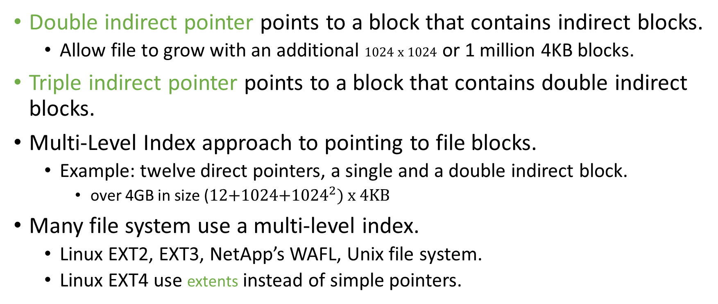
The Multi-Level Index (Cont.)
Double indirect pointer points to a block that contains indirect blocks.
Allow file to grow with an additional 1024 x 1024 or 1 million 4KB blocks.
Triple indirect pointer points to a block that contains double indirect blocks.
Multi-Level Index approach to pointing to file blocks.
Example: twelve direct pointers, a single and a double indirect block.
over 4GB in size (12+1024+${1024}^{2}) x 4KB$
Many file system use a multi-level index.
Linux EXT2, EXT3, NetApp’s WAFL, Unix file system.
Linux EXT4 use extents instead of simple pointers.

Slide 23
File Statistics
Most files are small Roughly 2K is the most common size
Average file size is growing Almost 200K is the average
Most bytes are stored in large files A few big files use most of the space
File systems contains lots of files Almost 100K on average
File systems are roughly half full Even as disks grow, file system remain -50% full
Directories are typically small Many have few entries; most have 20 or fewer
File System Measurement Summary

Slide 24
Directory Organization
Directory contains a list of (entry name, inode number) pairs.
Each directory has two extra files .”dot” for current directory and ..”dot-dot” for parent directory
For example, dir has three files (foo, bar, foobar):
inum | reclen | strlen | name
5 4 2 .
2 4 3 ..
12 4 4 foo
13 4 4 bar
24 8 7 foobar

Slide 25
Free Space Management
File system tracks which inodes and data blocks are free or not.
In order to manage free space, we have two simple bitmaps.
When file is newly created, it is allocated inode by searching the inode bitmap and update on-disk bitmap.
Pre-allocation policy is commonly used for allocation of contiguous blocks.

Slide 26
Access Paths: Reading a File From Disk
Issue an open(“/foo/bar”, O_RDONLY),
Traverse the pathname and thus locate the desired inode.
Begin at the root of the file system (/)
In most Unix file systems, the root inode number is 2
Filesystem reads in the block that contains inode number 2.
Look inside of it to find pointer to data blocks (contents of the root).
By reading in one or more directory data blocks, It will find “foo” directory.
Traverse recursively the path name until the desired inode (“bar”)
Check finale permissions, allocate a file descriptor for this process and returns file descriptor to user.

Slide 27
Access Paths: Reading a File From Disk (Cont.)
Issue read() to read from the file.
Read in the first block of the file, consulting the inode to find the location of such a block.
Update the inode with a new last accessed time.
Update in-memory open file table for file descriptor, the file offset.
When file is closed:
File descriptor should be deallocated, but for now, that is all the file system really needs to do. No disk I/Os take place.

Slide 28
Access Paths: Reading a File From Disk (Cont.)
 | data bitmap | inode bitmap | root inode | foo inode | bar inode | root data | foo data | bar data[0] | bar data[1] | bar data[2]
open(bar) |  |  | read | read | read | read | read
read() |  |  |  |  | read write |  |  | read
read() |  |  |  |  | read write |  |  |  | read
read() |  |  |  |  | read write |  |  |  |  | read
File Read Timeline (Time Increasing Downward)

Slide 29
Access Paths: Writing to Disk
Issue write() to update the file with new contents.
File may allocate a block (unless the block is being overwritten).
Need to update data block, data bitmap.
It generates five I/Os:
one to read the data bitmap
one to write the bitmap (to reflect its new state to disk)
two more to read and then write the inode
one to write the actual block itself.
To create file, it also allocates space within the directory containing the file, causing high I/O traffic.

Slide 30
Access Paths: Writing to Disk (Cont.)
 | data bitmap | inode bitmap | root inode | foo inode | bar inode | root data | foo data | bar data[0] | bar data[1] | bar data[2]
create (/foo/bar) |  | read write | read | read write | read write | read | read write
write() | read write |  |  |  | read write |  |  | write
write() | read write |  |  |  | read write |  |  |  | write
write() | read write |  |  |  | read write |  |  |  |  | write
File Creation Timeline (Time Increasing Downward)

Slide 31
Caching and Buffering
Reading and writing files are expensive, incurring many I/Os.
For example, long pathname(/1/2/3/…./100/file.txt)
One to read the inode of the directory and at least one to read its data.
Literally performs hundreds of reads just to open the file.
In order to reduce I/O traffic, file systems aggressively use system memory (DRAM) to cache.
Early file systems use fixed-size cache to hold popular blocks.
Static partitioning of memory can be wasteful;
Modem systems use dynamic partitioning approach, unified page cache.
Read I/O can be avoided by large cache.

Slide 32
Caching and Buffering (Cont.)
Write traffic has to go to disk for persistence. Thus, cache does not reduce write I/Os.
File system uses write buffering for write performance benefits.
delaying the writes (file system batches some updates into a smaller set of I/Os).
By buffering a number of writes in memory, the file system can then schedule the subsequent I/Os more efficiently.
By avoiding writes
Some applications force flush data to disk by calling fsync()or makes direct I/O.

Slide 33
How about Windows?

Slide 35
Last Words (Where could we go from here?)
«With every release, software gets more complex and less secure until the only security left is job security.»
- Al Eldridge
Further courses taught by me: BGK503, BGK504, others.
Apply for Internship/Part-time positions at Securify (the company I’ve co-founded).

